Slide 1
Fencing Post Detection and
Auto Referee
Yucheng Zhu CS207 Final Project

Slide 2
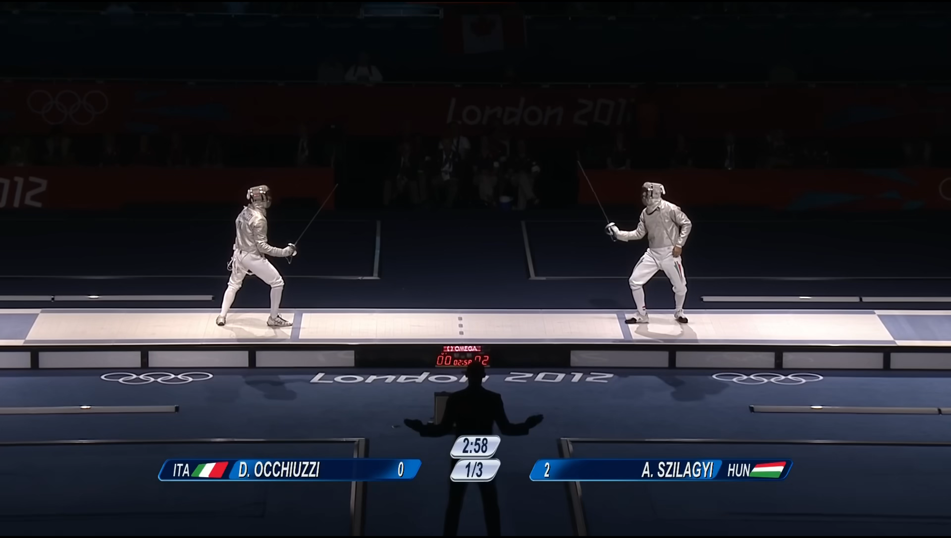
Preliminary: how fencing referee judge double hit
Check whose arm extension (attack) first
Check whose lunge first
Check whose launch first
But saber is too fast, everything is done in 1 seconds.
Even if the referee have the slow motion, it is still hard to judge

Slide 3
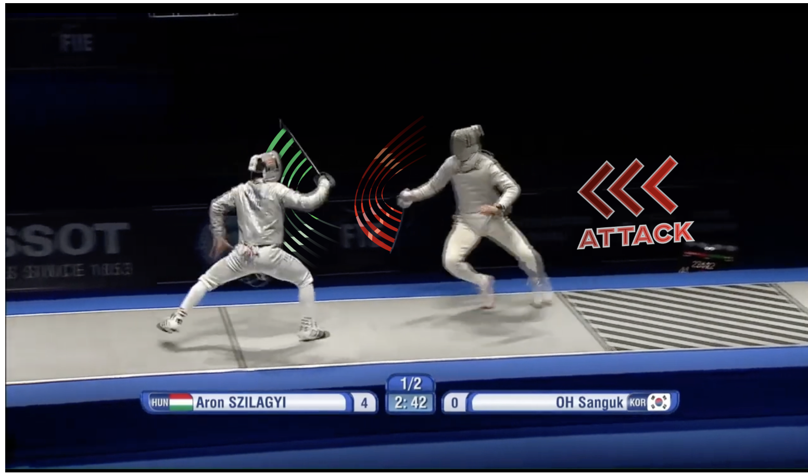
Related work:
Allez Go: Computer Vision and Audio Analysis for AI Fencing Referees
  Multimodal audio-visual fusion for automated refereeing
  First attempt to use audio cues instead of purely visual methods
  Lightweight TCN-based temporal modeling
FERA: Foil Fencing Referee Assistant Using Pose-Based Multi-Label Move Recognition and Rule Reasoning
  End-to-end priority reasoning pipeline (perception → action classification → rule inference)
  Publicly released dataset and evaluation benchmark
  First application of LLM-based reasoning to fencing refereeing rules
FenceNet: Fine-Grained Footwork Recognition in Fencing
  No wearable sensors required; relies solely on 2D pose data
  BiFenceNet captures bidirectional temporal dynamics in movement
  One of the earliest works enabling direct video-based fencing footwork recognition
Allez Go: marking priority (attack) to help automated refereeing

Slide 4
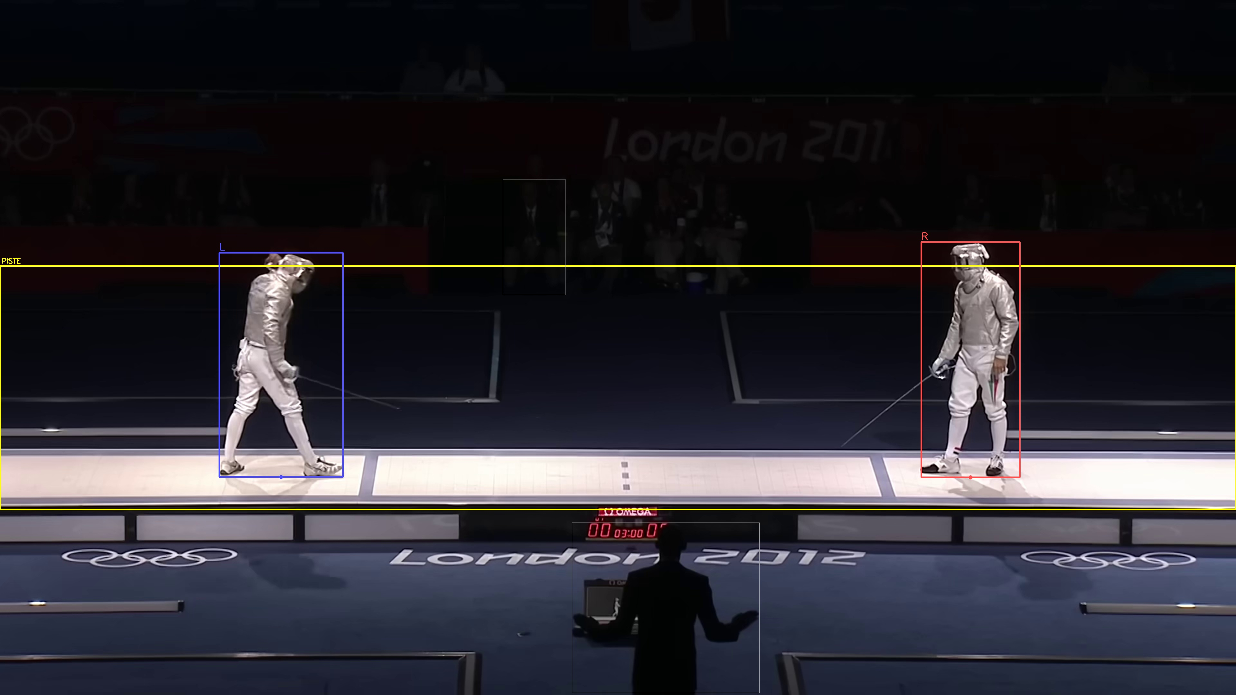
Core Design: Temporal Segmentation
Multimodal Event Monitoring
  Audio: referee vocal commands (Allez ) and electronic scoring buzzer activations.
  Vision: scoring apparatus indicator lights and athlete pose states
Figure selections
  Piste: The ground for fencing
  Athletes: The biggest human body on the piste
  Score machine light: red or green

Slide 5
Core Design: Motion Detection
Baseline detection
  athlete’s static on-guard joint angles serving as the reference zero-point for all subsequent motion thresholds
Lunge detection
  the primary offensive move-ment and the clearest physical expression of an attack on foot
Attack detection
  Joint angles on arm and shoulder
Pause detection
  A pause event signals that an athlete’s forward action hasbeen interrupted after launch, causing loss of priority

Slide 6
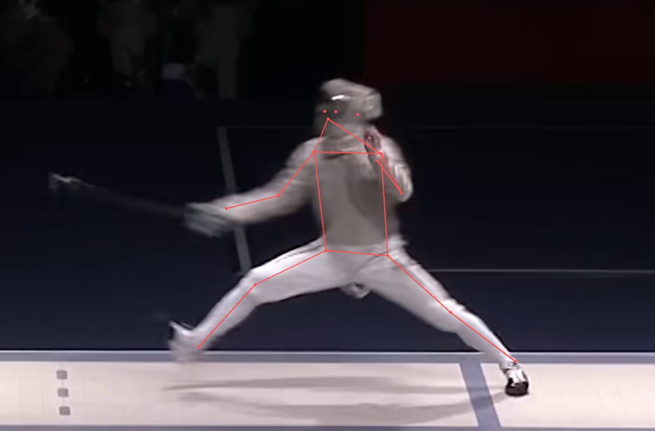
Lunge Detection
Angle inter-thigh
>120°
Angle of the front knee joint
>150°
Width between two feet>2*width baseline

Slide 7
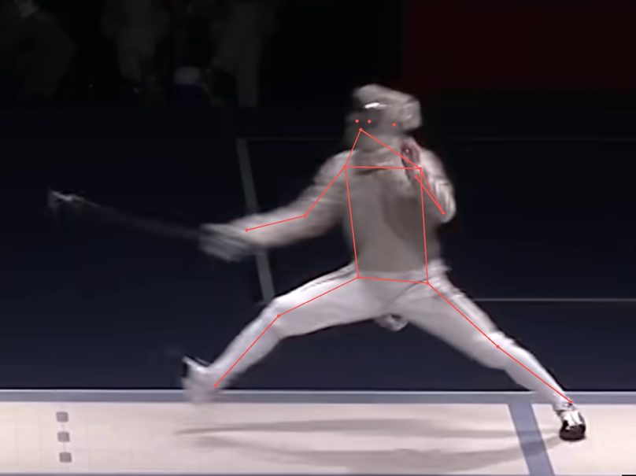
Attack detection
Elbow angle>140°
Shoulder angle>60°

Slide 8
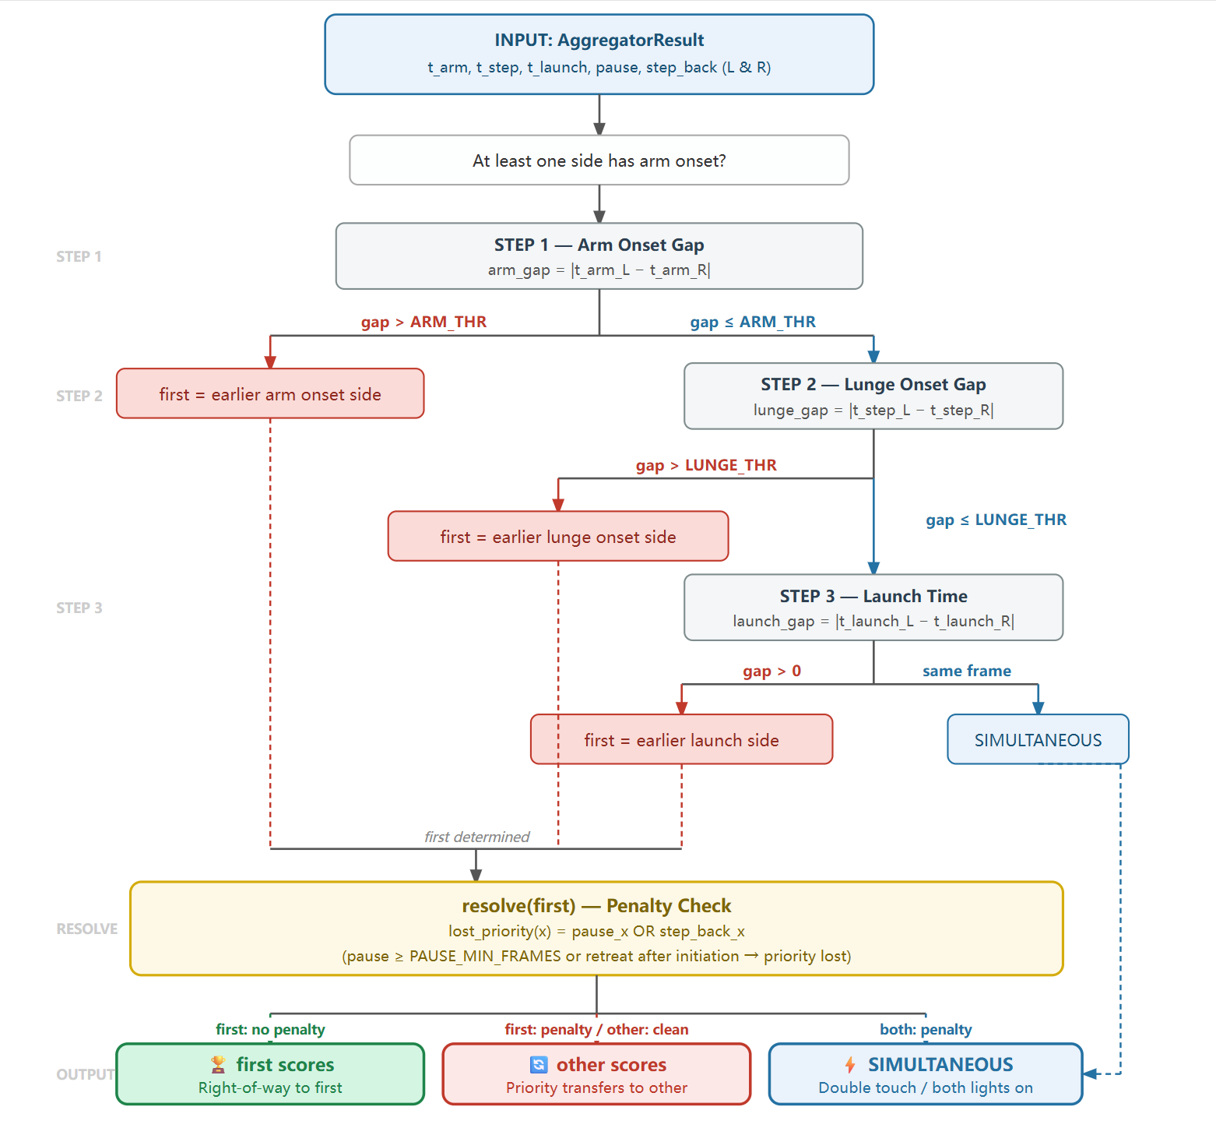
Core Design: Priority Decision Workflow
It follows up with the most resent fencing rules
Step 1 — Arm Onset. The algorithm first compares the arm-onset times of both fencers (the time of attack). Threshold=2 frame
Step 2 — Lunge Onset. Step 2 compares lunge-onset times. A lunge represents the committed forward displacement of the body. Threshold=2 frame
Step 3 — Launch Time. Step 3 compares raw launch times with 10 frame simultaneity threshold. Threshold=10 frame
Step 4 -- Forfeiture Check: No pause or step back ward in the whole attacking process after launch.

Slide 9
Output Result: Log (from debug_aggregator
Verdict process
INFO Priority step 1: arm gap=1 ≤ 3 → check lunge
INFO Priority step 2: lunge gap=1 ≤ 3 → check launch
INFO Priority step 3: launch gap=12 > 10 → first_mover=L
INFO Priority step 3: first_mover=L penalty=False | other=R penalty=False
=================================================================
Event Table
INFO SYSTEM LEFT RIGHT
INFO f0009 0.30s BASELINE_CAPTURED
INFO f0016 0.53s WINDOW_OPEN
INFO f0020 0.67s LAUNCH
INFO f0032 1.07s LAUNCH
INFO f0041 1.37s ATTACK_START
INFO f0042 1.40s ATTACK_START
INFO f0042 1.40s LUNGE
INFO f0043 1.43s LUNGE
INFO f0044 1.47s LIGHT_ON_L
INFO f0046 1.53s LIGHT_ON_R
INFO f0046 1.53s LIGHT_ON_BOTH
INFO f0056 1.87s WINDOW_CLOSE
INFO KEY TIMESTAMPS (frame | seconds @ 30 fps)
INFO T_arm_L f0042 1.40s
INFO T_arm_R f0041 1.37s
INFO T_step_L f0042 1.40s
INFO T_step_R f0043 1.43s
INFO T_launch_L f0020 0.67s
INFO T_launch_R f0032 1.07s
INFO pause_L = False | pause_R = False
INFO step_back_L = False | step_back_R = False
Result VERDICT: Verdict.LEFT_SCORES

Slide 10
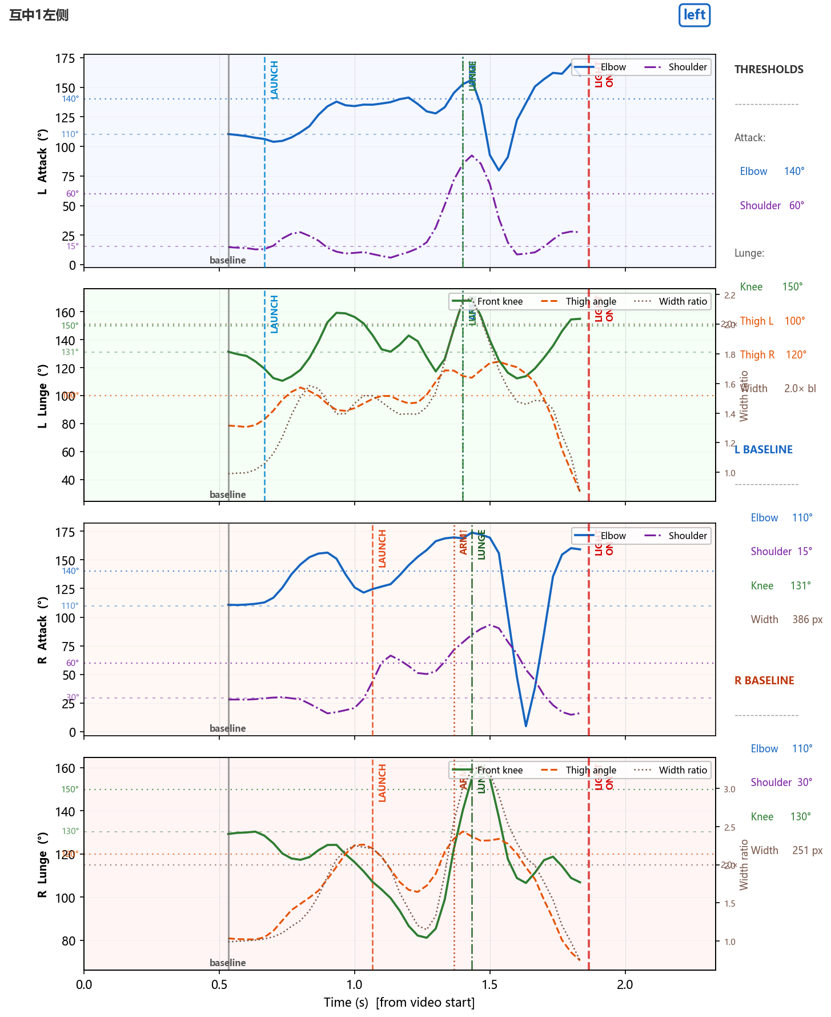
Output Result: visualization
Verdict result by the algorihtm
File name and truth result
Lunge values
Knee angle>150
Thigh angle:
  Left: >100
  Right:>120
Stance width: >2*of baseline width
Thigh value is different for left and right side is because the project of the camera and the body angle influence
Attack joint angle
Elbow>140
Shoulder>60

Slide 11
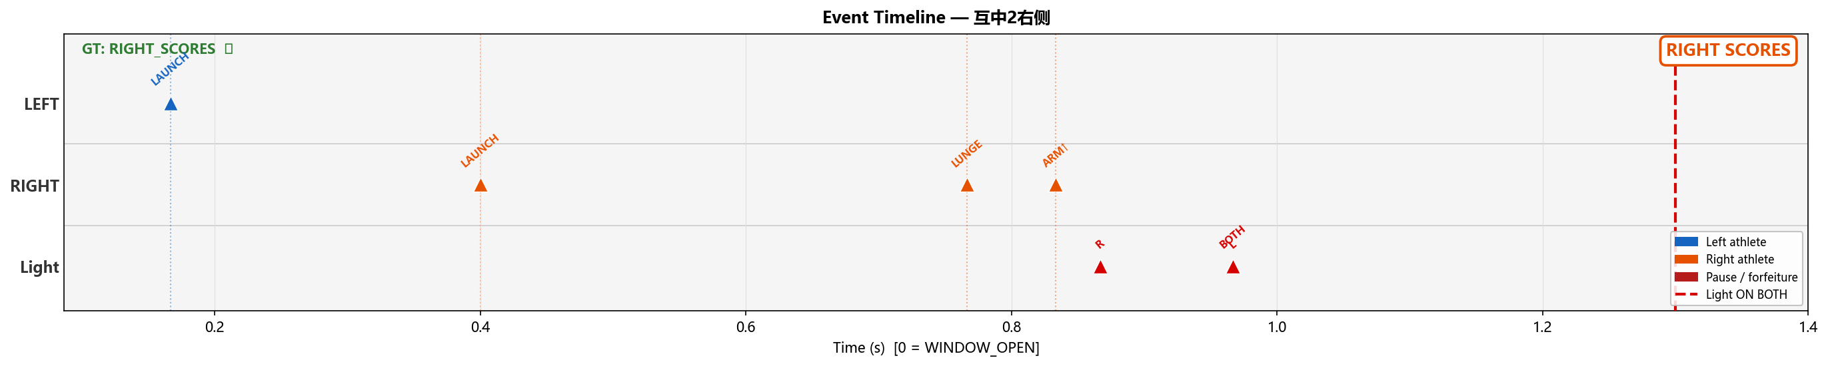
Output Result: Event visualization
The event output will help the judge to see when which event is happened. It will be easier to compare different athletes’ action and their difference of time.

Slide 12
Accuracy
Video GT Predicted Match
互中1左侧 LEFT_SCORES LEFT_SCORES ✓
互中2右侧 RIGHT_SCORES RIGHT_SCORES ✓
互中3右侧 RIGHT_SCORES RIGHT_SCORES ✓
互中4右侧 RIGHT_SCORES RIGHT_SCORES ✓
互中5右侧 RIGHT_SCORES LEFT_SCORES ✗
互中5右侧慢动作 RIGHT_SCORES RIGHT_SCORES ✓
同时1 SIMULTANEOUS SIMULTANEOUS ✓
同时2 SIMULTANEOUS SIMULTANEOUS ✓
同时3 SIMULTANEOUS SIMULTANEOUS ✓
同时4 SIMULTANEOUS SIMULTANEOUS ✓
同时飞剑-1 SIMULTANEOUS LEFT_SCORES ✗
Labelled videos : 11
Correct : 9
Accuracy : 81.8%
In the 11 test cases, the accuracy is 81%
For the future, I should also get a larger data set to test on the accuracy on the algorithm

Slide 13
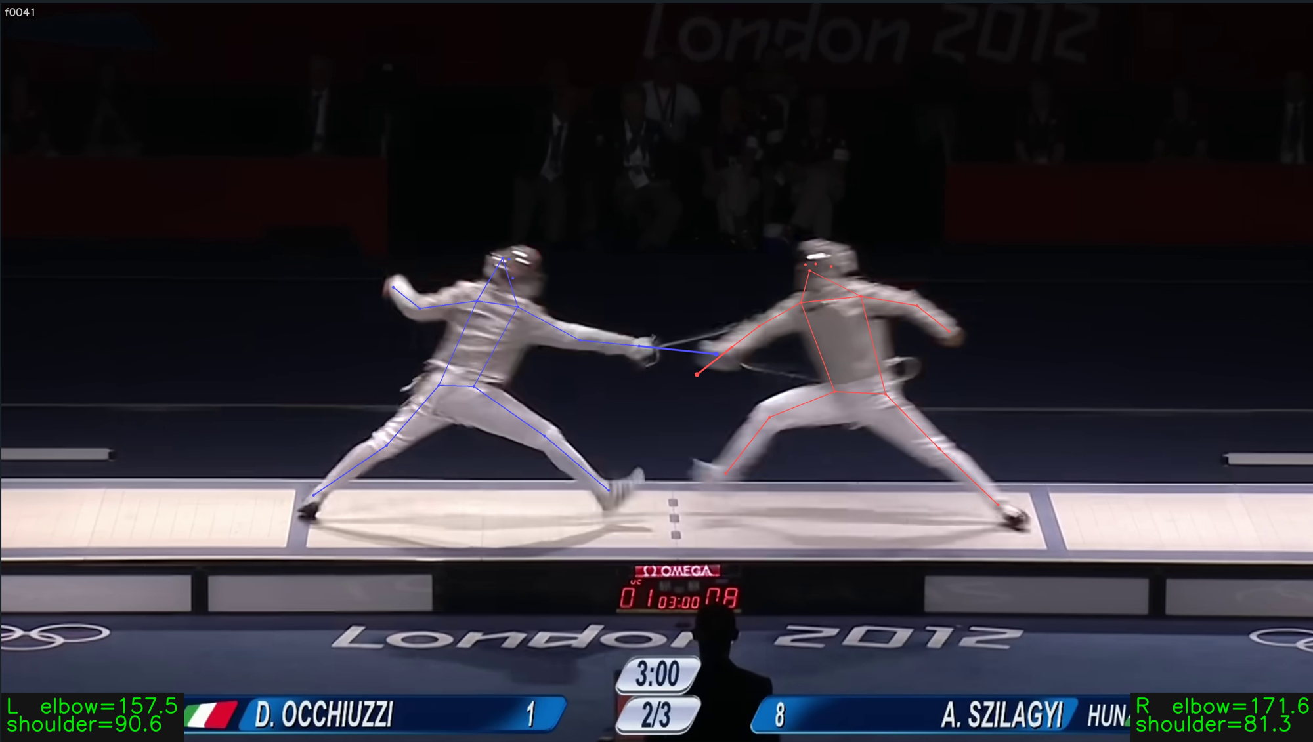
Need improvement: sword tracking
Sword detection will help a lpt in define the priority of attack
There is no such data set or library to tracking yet

